Slide 1
Adwentureworks sales presentation
Andrius Tunaitis

Slide 2
How is the business doing?
KPI’s for 2004 Jan-Jul: Compared to previous year:
Total Sales: 32.2M $ 34.3 %
Number of sales: 14K 371.3 %
Average sale value: 2.3K $ -71.5 %

Slide 3
How are the sales looking?
Data for 2001 starts from July.
Data for 2004 is until the end of July. Last month (July) contains only online sales.
To do:
Report 2004 July offline sales.
Investigate 2004 July data.
Reevaluate projections for 2004. Data for

Slide 4
How about the average sale value?
In August of 2003 average sale value dropped to roughly half the previous value.

Slide 5
What happened in August 2003?
In August of 2003 number of online sales tripled in size.
AOV offline (2004 08) 31.4k $
AOV online (2004 08) 595 $

Slide 6
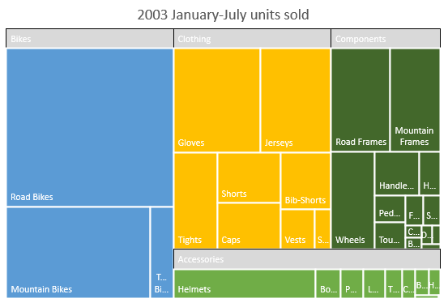
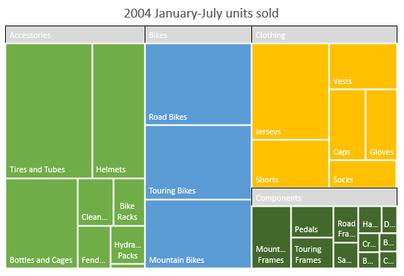
Why the sudden drop in sale value?
Accessories segment increase → reduced average sale value.

Slide 7
How does the segment dynamic look?
Accessories segment increased 5 times.
To do:
Cross sell other segments.

Slide 8
How about online vs offline sales?
For the last year online sales have been steadily growing.

Slide 9
What is average online sale value?
Canada is 2nd in total sales, but last in online sales.
Since 2003 Canada’s AOV of online sales is significantly lower than of other countries.
Canada’s sales department should collaborate with departments from other countries.

Slide 10
Conclusions:
Data for 2004 July should be investigated and fully reported. This will allow to have a clearer 2004 projection.
Employ cross selling practices in order to see increase of sales in different segments.
Online sales in Canada should be discussed with colleagues from other countries in order to resolve very low average sale value.

Slide 11
Questions?

